Slide 1

UNIVERSITY INSTITUTE OF ENGINEERING
COMPUTER SCIENCE ENGINEERING
Bachelor of Engineering (Computer Science & Engineering)
Subject Name: Big Data Analytics
Subject Code: 20CST-471
Introduction to Map Reduce paradigm.
Mapped with CO3
Prepared By:
Er. Ankita Sharma
DISCOVER . LEARN . EMPOWER

Slide 2
Map Reduce paradigm.
Map Reduce is a programming paradigm that revolutionized the field of distributed computing, particularly in the context of processing vast amounts of data. Popularized by the Apache Hadoop framework, Map Reduce simplifies the development of scalable and fault-tolerant data processing applications.
The paradigm divides a large-scale computation into two key phases: the Map phase and the Reduce phase. In the Map phase, data is partitioned into manageable chunks, and a Map function is applied independently to each chunk, generating intermediate key-value pairs.

Slide 3
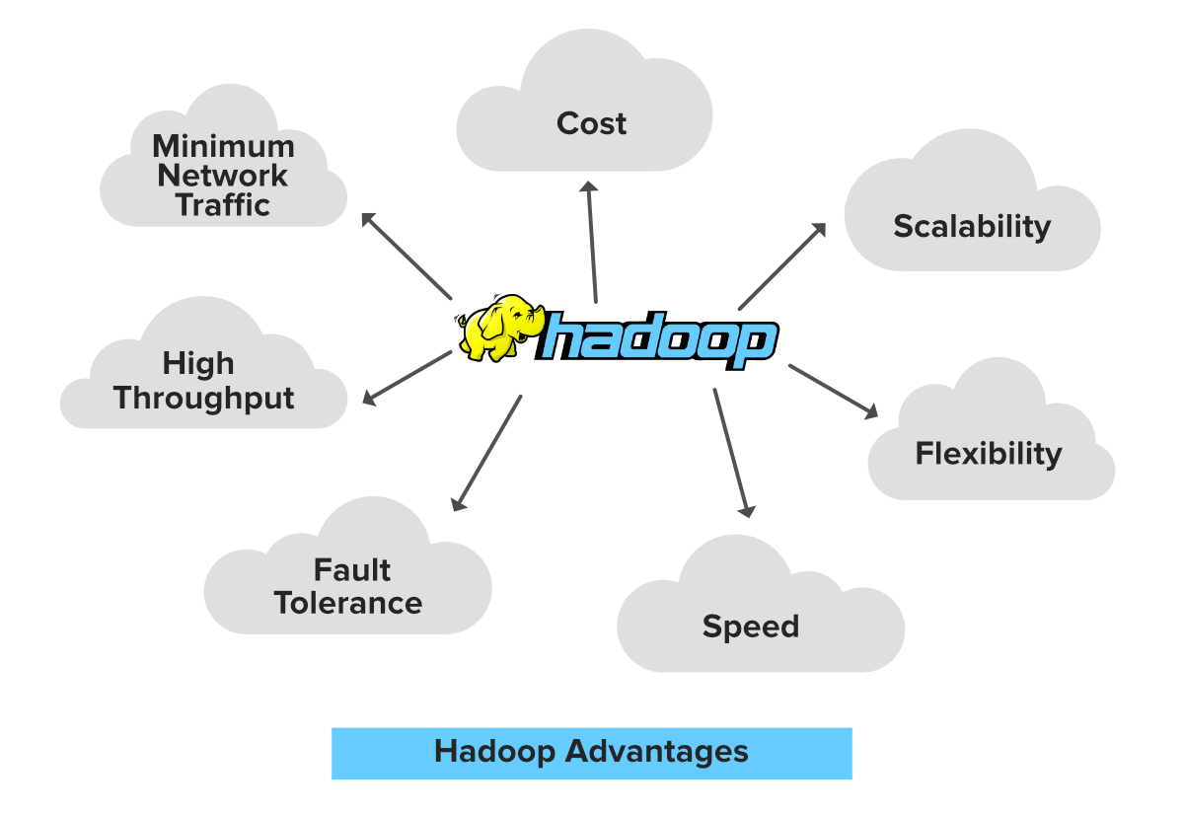
The Shuffle and Sort phase follows, organizing these intermediate pairs based on their keys. Subsequently, in the Reduce phase, data is grouped by key, and a Reduce function is applied to each group, producing the final output.

Slide 4
This approach facilitates parallelization, enabling efficient processing on distributed clusters of machines. Map Reduce has become a cornerstone in processing massive datasets, offering scalability, fault tolerance, and simplicity in building distributed data processing applications.
Map Reduce represents a paradigm shift in the domain of distributed data processing, offering a scalable and efficient framework for handling large-scale datasets. At its core, Map Reduce breaks down complex computations into two primary phases: Map and Reduce.

Slide 5
In the Map phase, input data is partitioned into manageable chunks, and a user-defined Map function is applied to each piece independently, transforming the data into a set of intermediate key-value pairs.
This phase allows for parallel processing, as different portions of the data can be handled concurrently across multiple nodes in a distributed system.

Slide 6
The intermediate key-value pairs are then sorted and shuffled based on their keys, preparing them for the subsequent Reduce phase. In the Reduce phase, data is grouped by key, and a user-defined Reduce function is applied to each group, generating the final output. The beauty of Map Reduce lies in its ability to abstract the complexities of distributed processing, offering automatic parallelization and fault tolerance.
The framework is particularly well-suited for batch processing tasks, such as log analysis, data transformation, and large-scale computations, making it a cornerstone in the toolkit of big data analytics.

